Slide 1
CSC410 - Professional Practices in IT
Instructor Name : Sidra Nasir

Slide 2
Ethical Theories
Subjective Relativism
Cultural Relativism
Divine Command Theory
Ethical Egoism

Slide 3
What Is Relativism?
No universal norms of right and wrong
One person can say “X is right,” another can say “X is wrong,” and both can be right
Two Particular Kind of Relativism are:
Subjective Relativism
Cultural Relativism

Slide 4

Subjective Relativism
– Each person decides right and wrong for himself or herself
– “What’s right for you may not be right for me”

Slide 5
Case for Subjective Relativism
Well-meaning and intelligent people disagree on moral issues .e.g. Animal Rights.
Ethical debates are disagreeable and pointless. E.g.

Slide 6
Case Against Subjective Relativism
Blurs line between doing what you think is right and doing what you want to do
Makes no moral distinction between the actions of different people
Subjective relativism and tolerance are two different things
Decisions may not be based on reason
Not a workable ethical theory

Slide 7
Cultural Relativism
Cultural Relativism in a Nutshell
What is “right” and “wrong” depends upon a society’s actual moral guidelines
These guidelines vary from place to place and from time to time
A particular action may be right in one society at one time and wrong in other society or at another time.

Slide 8
Case for Cultural Relativism
Different social contexts demand different moral guidelines
It is arrogant for one society to judge another

Slide 9
Case Against Cultural Relativism
Because two societies do have different moral views doesn’t mean they ought to have different views
It doesn’t explain how moral guidelines are determined
What if there are no cultural norms?
It doesn’t account for evolution of moral guidelines.
It provides no way out for cultures in conflict

Slide 10
Case Against Cultural Relativism
Existence of many acceptable practices does not imply all practices are acceptable (many/any fallacy)
Societies do, in fact, share certain core values
Only indirectly based on reason

Slide 11
Divine Command Theory
Overview of Divine Command Theory
Good actions: those aligned with God’s will
Bad actions: those contrary to God’s will
Holy books reveal God’s will
We should use holy books as moral decision-making guides

Slide 12
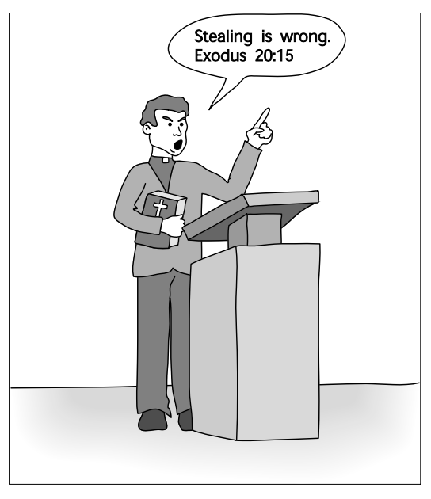
Divine Command Theory in Action

Slide 13
Case for Divine Command Theory
We owe obedience to our Creator
God is all-good and all-knowing
God is the ultimate authority

Slide 14
Case Against Divine Command Theory
Different holy books disagree on certain teachings
Society is multicultural, secular
Some modern moral problems not directly addressed in scripture
“The good” ≠ “God” (equivalence fallacy).
Based on obedience, not reason
Notes:
Instead, the statement “God is good” means there is an objective standard of goodness that God meets perfectly.

Slide 15
Ethical Egoism
Each person should focus exclusively on his or her self-interest
Morally right action: that action that provides self with maximum long-term benefit

Slide 16
Case for Ethical Egoism
It is practical since we are already inclined to do what’s best for ourselves
It is better to let other people take care of themselves
• The community can benefit when individuals put their well-being first
Other moral principles are rooted in the principle of self-interest

Slide 17
Case Against Ethical Egoism
An easy moral philosophy may not be the best moral philosophy
We know a lot about what is good for someone else
Self-interest can lead to blatantly immoral behavior
Other moral principles are superior to principle of self-interest
People who take the good of others into account lead happier lives
By definition, does not respect the ethical point of view

Slide 18
END OF LECTURE

